Slide 1

Veterans Affairs Participatory System Dynamic Platform (VA PSD)
November Monthly Status Update
November 30, 2017

Slide 2
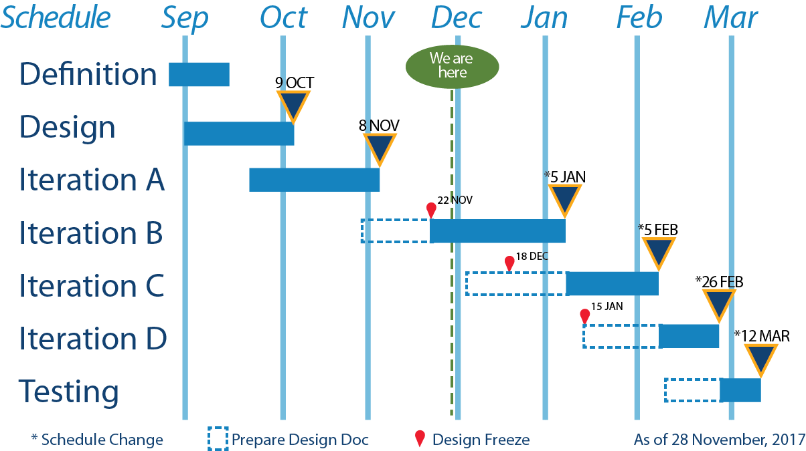
Status Report – for November 2017 Activities
 | Issues For Resolution We need approval of revised workplan. Models keep significantly changing. This continues to threaten the schedule, which has now slid 30 days to the right. We need training content (i.e., video and text). Finalization of Administrator/Facilitator expanded outputs tile (4 milestones). Sankey diagrams for PSY model – we are investigating. Simplified phone interface.
Tasks – Last 30 Days Completed Iteration A Development. Completed Iteration B Design Document. Multiple meetings with design team and stakeholders. Redesigned decision panels to incorporate PSY model design changes. Started Iteration C Design Document. | Upcoming Tasks Complete Iteration A testing and review . Complete Iteration B Development (05-JAN). Develop and complete Iteration C Design Document.
Notes:
Issues for Resolution:
Due to issues with model design changes, our schedule is now 30 days off the base schedule. We will investigate ways to shorten these development times; however, we are projecting a 12-MAR completion date.
We need training content. Are the educators going to provide us with information to put directly into the model? Or are we just going to provide screencasts of how to manipulate the simulation?
Can you please identify the 4 (or more) milestones that you want reported on the team’s progress? What are the key metrics about each team that you want to know?
We are looking into the feasibility of using Sankey diagrams to communicate outcomes for the PSY model. We will advise soonest.
We are thinking about simplifying the phone interface, to just the decision tile, calendar tile and output graphs. The challenge of the phone format (in terms of time) is fitting the systems schematic on the screen. This may present an opportunity to save some development time.

